Slide 1
IR Evaluation
Manish Gupta
Adapted from CS276, Stanford course on IR

Slide 2
Measures for a search engine
Sec. 8.6
How fast does it index
Number of documents/hour
How fast does it search
Latency as a function of index size
Expressiveness of query language
Ability to express complex information needs
Speed on complex queries
Uncluttered UI
Is it free?

Slide 3
Measures for a search engine
Sec. 8.6
All of the preceding criteria are measurable: we can quantify speed/size
The key measure: user happiness
What is this?
Speed of response/size of index are factors
But blindingly fast, useless answers won’t make a user happy
Need a way of quantifying user happiness

Slide 4
Measuring user happiness
Sec. 8.6.2
Issue: who is the user we are trying to make happy?
Depends on the setting
Web engine:
User finds what s/he wants and returns to the engine
Can measure rate of return users
User completes task – search as a means, not end
eCommerce site: user finds what s/he wants and buys
Is it the end-user, or the eCommerce site, whose happiness we measure?
Measure time to purchase, or fraction of searchers who become buyers?
Enterprise (company/govt/academic): Care about “user productivity”
How much time do my users save when looking for information?
Many other criteria having to do with breadth of access, secure access, etc.

Slide 5
Happiness: elusive to measure
Sec. 8.1
Most common proxy: relevance of search results
But how do you measure relevance?
Relevance measurement requires 3 elements:
A benchmark document collection
A benchmark suite of queries
A usually binary assessment of either Relevant or Nonrelevant for each query and each document
Some work on more-than-binary

Slide 6
Evaluating an IR system
Sec. 8.1
Note: the information need is translated into a query
Relevance is assessed relative to the information need not the query
E.g., Information need: I'm looking for information on whether drinking red wine is more effective at reducing your risk of heart attacks than white wine.
Query: wine red white heart attack effective
Evaluate whether the doc addresses the information need, not whether it has these words

Slide 7
Standard relevance benchmarks
Sec. 8.2
TREC - National Institute of Standards and Technology (NIST) has run a large IR test bed for many years
Reuters and other benchmark doc collections used
“Retrieval tasks” specified
sometimes as queries
Human experts mark, for each query and for each doc, Relevant or Nonrelevant
or at least for subset of docs that some system returned for that query

Slide 8
Unranked retrieval evaluation: Precision and Recall
Sec. 8.3
Precision: fraction of retrieved docs that are relevant = P(relevant|retrieved)
Recall: fraction of relevant docs that are retrieved
= P(retrieved|relevant)
Precision P = tp/(tp + fp)
Recall R = tp/(tp + fn)
 | Relevant | Nonrelevant
Retrieved | tp | fp
Not Retrieved | fn | tn

Slide 9
Should we instead use the accuracy measure for evaluation?
Sec. 8.3
Given a query, an engine classifies each doc as “Relevant” or “Nonrelevant”
The accuracy of an engine: the fraction of these classifications that are correct
(tp + tn) / ( tp + fp + fn + tn)
Accuracy is a commonly used evaluation measure in machine learning classification work
Why is this not a very useful evaluation measure in IR?

Slide 10
Why not just use accuracy?
Sec. 8.3
How to build a 99.9999% accurate search engine on a low budget….
People doing information retrieval want to find something and have a certain tolerance for junk.
Snoogle.com
Search for:
0 matching results found.

Slide 11
Precision/Recall
Sec. 8.3
You can get high recall (but low precision) by retrieving all docs for all queries!
Recall is a non-decreasing function of the number of docs retrieved
In a good system, precision decreases as either the number of docs retrieved or recall increases

Slide 12
Difficulties in using precision/recall
Sec. 8.3
Should average over large document collection/query ensembles
Need human relevance assessments
Assessments have to be binary
Heavily skewed by collection/authorship
Results may not translate from one domain to another

Slide 13
A combined measure: F
Sec. 8.3
Combined measure that assesses precision/recall tradeoff is F measure (weighted harmonic mean):
People usually use balanced F₁ measure
i.e., with β = 1 or α = ½
Harmonic mean is a conservative average
See CJ van Rijsbergen, Information Retrieval

Slide 14
Evaluating ranked results
Sec. 8.4
Evaluation of ranked results:
The system can return any number of results
By taking various numbers of the top returned documents (levels of recall), the evaluator can produce a precision-recall curve

Slide 15
A precision-recall curve
Sec. 8.4

Slide 16
Averaging over queries
Sec. 8.4
A precision-recall graph for one query isn’t a very sensible thing to look at
You need to average performance over a whole bunch of queries.
But there’s a technical issue:
Precision-recall calculations place some points on the graph
How do you determine a value (interpolate) between the points?

Slide 17
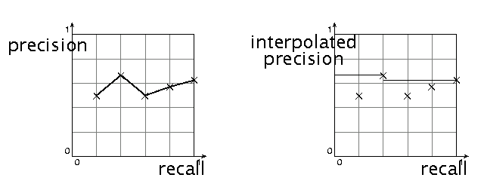
Interpolated precision
Sec. 8.4
Idea: If locally precision increases with increasing recall, then you should get to count that…
So you take the max of precisions to right of value

Slide 18
Evaluation
Sec. 8.4
Graphs are good, but people want summary measures!
Precision at fixed retrieval level
Precision-at-k: Precision of top k results
Perhaps appropriate for most of web search: all people want are good matches on the first one or two results pages
But has an arbitrary parameter of k
11-point interpolated average precision
The standard measure in the early TREC competitions: you take the precision at 11 levels of recall varying from 0 to 1 by tenths of the documents, using interpolation (the value for 0 is always interpolated!), and average them
Evaluates performance at all recall levels

Slide 19
Typical (good) 11 point precisions
Sec. 8.4
SabIR/Cornell 8A1 11pt precision from TREC 8 (1999)

Slide 20
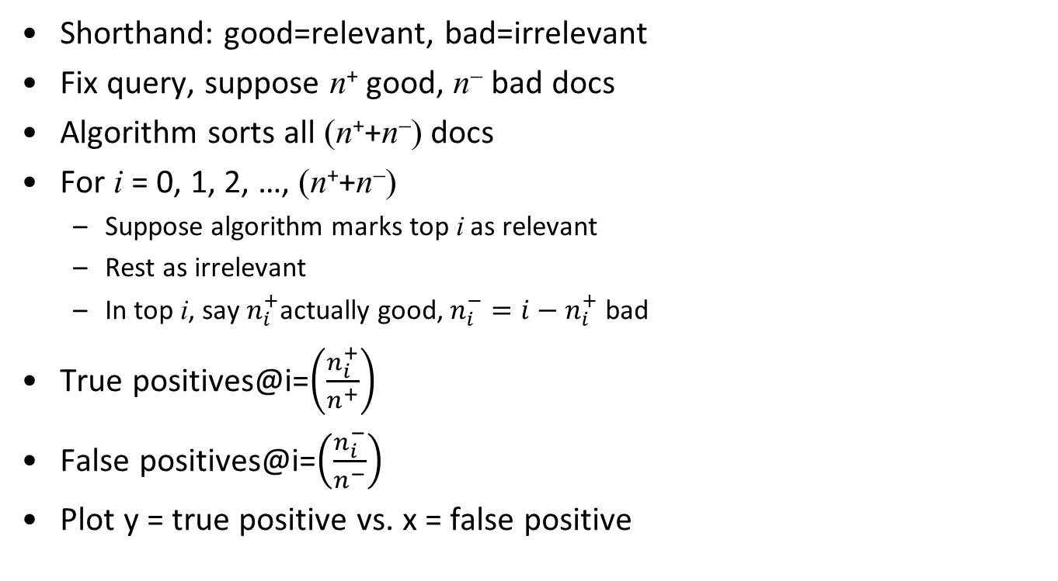
ROC Curve
Notes:
$\noindent $\text{true positive@}i = (n_i^+/n^+)$ \\ \noindent $\text{false positive@}i = (n_i^-/n^-)$

Slide 21
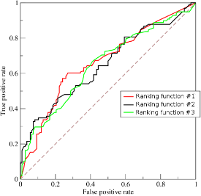
Area under ROC Curve (AUC)
ROC = Receiver Operating Characteristic curve
Suppose ranking is random
Will get roughly diagonal line
Good ranking functions
Will get very high true positive at very small false positive rates
Large lift above diagonal
Measure area under the curve
½ ⇒ effectively random
Close to 1 ⇒ good ranking algorithm

Slide 22
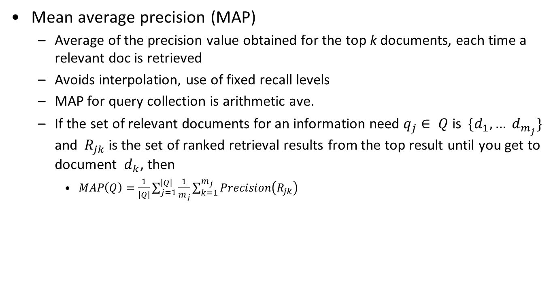
Yet more evaluation measures…
Sec. 8.4

Slide 23
R-precision
If we have a known (though perhaps incomplete) set of relevant documents of size Rel, then calculate precision of the top Rel docs returned
Perfect system could score 1.0.

Slide 24
Variance
Sec. 8.4
For a test collection, it is usual that a system does crummily on some information needs (e.g., MAP = 0.1) and excellently on others (e.g., MAP = 0.7)
Indeed, it is usually the case that the variance in performance of the same system across queries is much greater than the variance of different systems on the same query.
That is, there are easy information needs and hard ones!

Slide 25
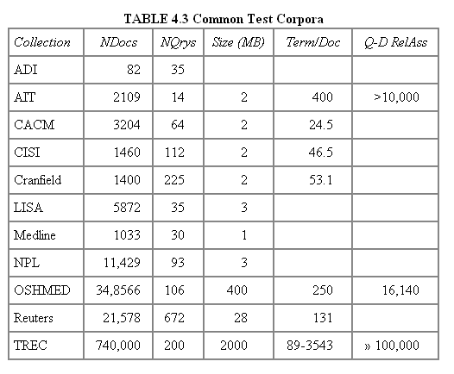
Test Collections
Sec. 8.5

Slide 26
From document collections to test collections
Sec. 8.5
Still need
Test queries
Relevance assessments
Test queries
Must be related to the docs available
Best designed by domain experts
Random query terms generally not a good idea
Relevance assessments
Human judges, time-consuming
Are human panels perfect?

Slide 27
Kappa measure for inter-judge (dis)agreement
Sec. 8.5
Kappa measure
Agreement measure among judges
Designed for categorical judgments
Corrects for chance agreement
Kappa = [ P(A) – P(E) ] / [ 1 – P(E) ]
P(A) – proportion of time judges agree
P(E) – what agreement would be by chance
Kappa = 0 for chance agreement, 1 for total agreement.

Slide 28
Kappa Measure: Example
Sec. 8.5
P(A)? P(E)?
Number of docs | Judge 1 | Judge 2
300 | Relevant | Relevant
70 | Nonrelevant | Nonrelevant
20 | Relevant | Nonrelevant
10 | Nonrelevant | Relevant

Slide 29
Kappa Example
Sec. 8.5
P(A) = 370/400 = 0.925
P(nonrelevant) = (10+20+70+70)/800 = 0.2125
P(relevant) = (10+20+300+300)/800 = 0.7878
P(E) = 0.2125^2 + 0.7878^2 = 0.665
Kappa = (0.925 – 0.665)/(1-0.665) = 0.776
Kappa > 0.8 = good agreement
0.67 < Kappa < 0.8 -> “tentative conclusions” (Carletta ’96)
Depends on purpose of study
For >2 judges: average pairwise kappas

Slide 30
TREC
Sec. 8.2
TREC Ad Hoc task from first 8 TRECs is standard IR task
50 detailed information needs a year
Human evaluation of pooled results returned
A TREC query (TREC 5)
<top>
<num> Number: 225
<desc> Description:
What is the main function of the Federal Emergency Management Agency (FEMA) and the funding level provided to meet emergencies? Also, what resources are available to FEMA such as people, equipment, facilities?
</top>

Slide 31
Standard relevance benchmarks: Others
Sec. 8.2
GOV2
Another TREC/NIST collection
25 million web pages
Largest collection that is easily available
But still many orders of magnitude smaller than what Google/Yahoo/Bing index
NTCIR
East Asian language and cross-language information retrieval
Cross Language Evaluation Forum (CLEF)
This evaluation series has concentrated on European languages and cross-language information retrieval.
Many others

Slide 32
Impact of Inter-judge Agreement
Sec. 8.5
Impact on absolute performance measure can be significant (0.32 vs 0.39)
Little impact on ranking of different systems or relative performance
Suppose we want to know if algorithm A is better than algorithm B
A standard information retrieval experiment will give us a reliable answer to this question.

Slide 33
Evaluation at large search engines
Sec. 8.6.3
Search engines have test collections of queries and hand-ranked results
Recall is difficult to measure on the web
Search engines often use precision at top k, e.g., k = 10
. . . or measures that reward you more for getting rank 1 right than for getting rank 10 right.
NDCG (Normalized Cumulative Discounted Gain)
Search engines also use non-relevance-based measures.
Clickthrough on first result
Not very reliable if you look at a single clickthrough … but pretty reliable in the aggregate.
Studies of user behavior in the lab
A/B testing
Notes:
Not very reliable if you look at a single clickthrough (you may
realize after clicking that the summary was misleading and the
document is nonrelevant) . . .

Slide 34
Normalized Discounted Cumulative Gain
Fix query q
Relevance level of document ranked j wrt q be r_{q}(j)
r_{q}(j)=0 means totally irrelevant
Response list is inspected up to rank L
Discounted cumulative gain for query q is
Z_{q} is a normalization factor that ensures the perfect ordering has NDCG_{q} = 1
Overall NDCG is average of NDCG_{q} over all q
No notion of recall, only precision at low ranks
cumulative
gain
normalized
rank discount
Notes:
\begin{align*}
\text{NDCG}_q =
Z_q \sum_{j = 1}^L \frac{2^{r_q(j)} - 1}{\log(1 + j)}
\end{align*}

Slide 35
A/B testing
Sec. 8.6.3
Purpose: Test a single innovation
Prerequisite: You have a large search engine up and running.
Have most users use old system
Divert a small proportion of traffic (e.g., 1%) to the new system that includes the innovation
Evaluate with an “automatic” measure like clickthrough on first result
Now we can directly see if the innovation does improve user happiness.
Probably the evaluation methodology that large search engines trust most
In principle less powerful than doing a multivariate regression analysis, but easier to understand

Slide 36
Critique of pure relevance
Sec. 8.5.1
Relevance vs Marginal Relevance
A document can be redundant even if it is highly relevant
Duplicates
The same information from different sources
Marginal relevance is a better measure of utility for the user.
Using facts/entities as evaluation units more directly measures true relevance.
But harder to create evaluation set
Diversity of search results?
Other factors: Freshness? Trustworthiness?

Slide 37
Thanks!

